Slide 1
Common Obstacles to Getting a Videophone

Slide 2
IT Department
Security
Firewall
Approved by Agency

Slide 3
HR/Boss
What the heck is a VP?
TTYs
DHH don’t need VPs
Approved by Agency

Slide 4
You
Education
Rights

Slide 5
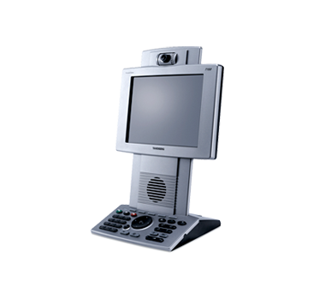
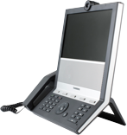
The Z™ Videophones
Z-150
Z-20

Slide 6
The Z™ Features
My Contacts | Online phone book.
Z Alert | Be alerted via email when a call is coming.
My Mail | Full featured video answering machine.
Digital Whiteboard | No more misunderstanding or missing information.
VCO Plus | Use your own voice through ZVRS platform without 2nd phone line.
DTMF/Touch-Tone | Navigate automated system without involvement of interpreter.
Team Video Meeting | Video Conference Bridge for Z-150, Z4, and Z4 Mobile users!

Slide 7
The Z™ Features
HolaVRS | Communicate with hearing Spanish speakers without barrier.
Z Box | Uses your existing flasher system such as Sonic Alert.
1Number | Choose a primary number with us and up to 4 of your VPs will ring.
Interpreter Access | Interpreter can call your VRS, VCO, and SPA contacts by name.
Video Remote Interpreting | Need an interpreter for family meetings, work, etc.? We provide on-demand interpreting for a cost!

