Slide 1
GovLoop Academy
Accelerating Your Government Career with Social Media
Andrew Krzmarzick
Vice President, Learning and Development
GovLoop

Slide 2
It All Begins With…

Slide 3
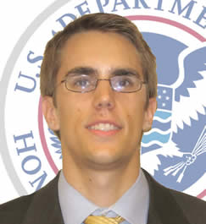
A Social Media Career Story

Slide 4
How do you rise above?

Slide 5
Our Time Together Today
You:
Pick 4-5 that work for you
Me:
6 Tools
30+ Ideas

Slide 7
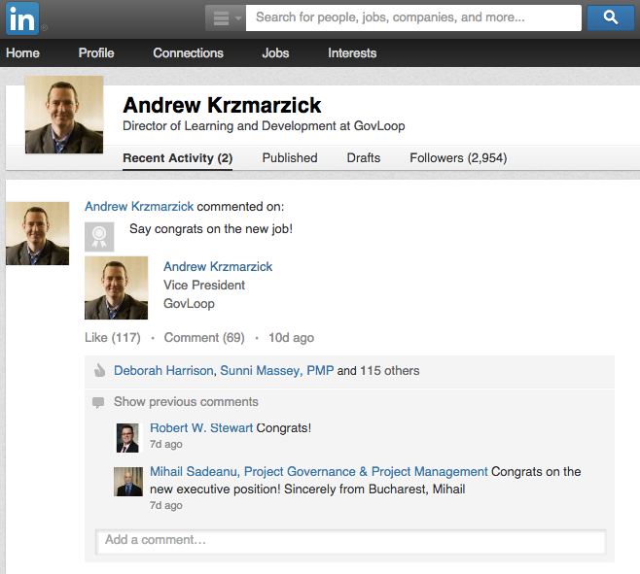
: Update Your Profile!

Slide 8
: Keep in Touch

Slide 9
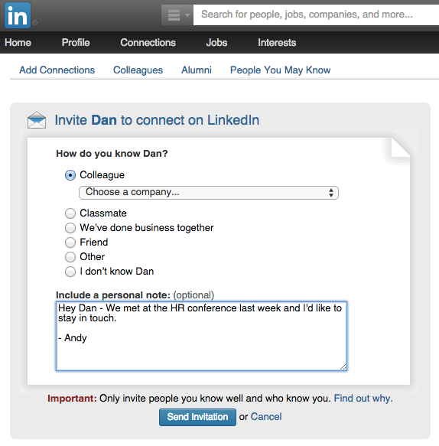
: Connect With Context

Slide 10
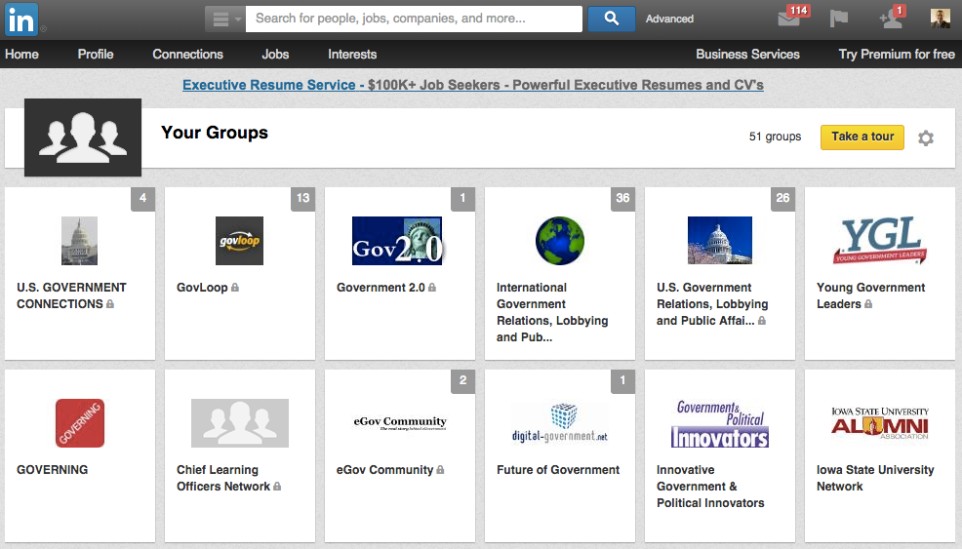
: Leverage Groups

Slide 11
: Jeffrey’s Story
Started Chief Learning Officers Network on LinkedIn in late November 2008.
Goal: get 20-30 folks over a year or so.
“I started the group because nothing was in existence in LinkedIn and our community needed something – a place, a forum, something to communicate around ideas.”
Within one year: 2,000+ group members

Slide 13
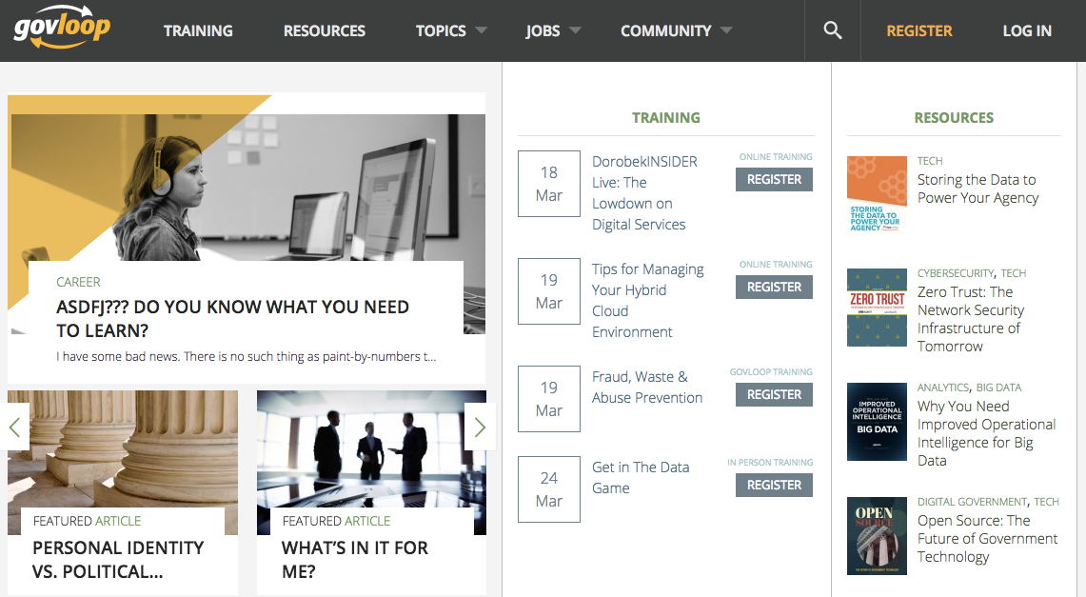
: Get Smart, Part 1

Slide 14
: Get Smart, Part 2

Slide 15
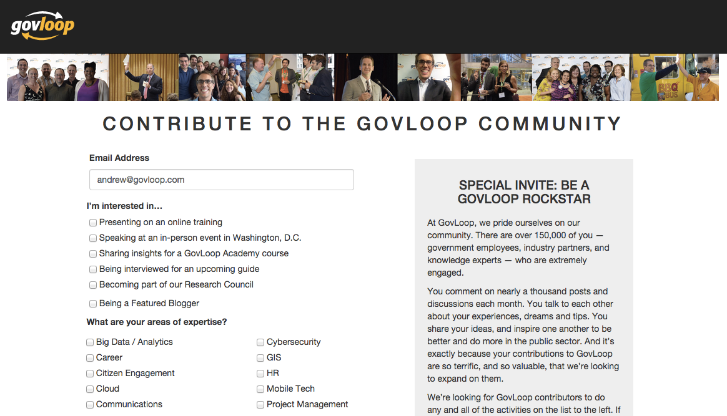
: Become an Expert
Notes:
Probably need new screen shots

Slide 16
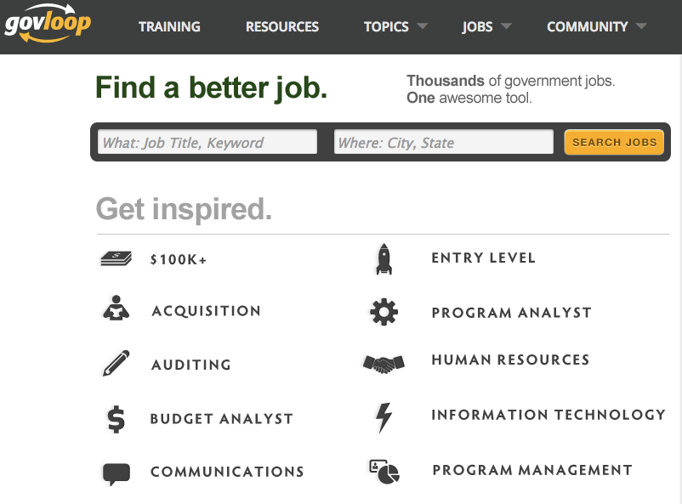
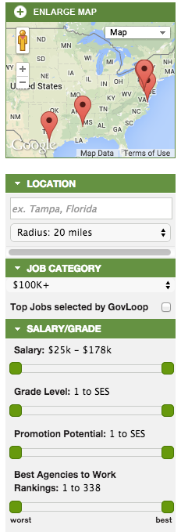
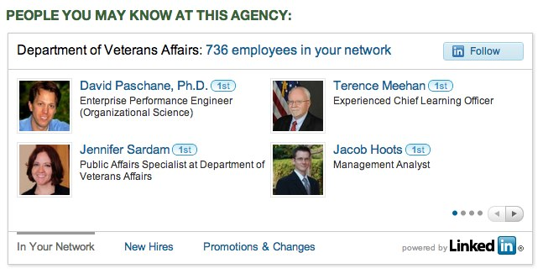
: Find Your Next Job
Notes:
Probably need new screen shots

Slide 17
: Get (or Be!) a Mentor
Notes:
Probably need new screen shots

Slide 18
: Sabrina’s Story
“…what I have come to like most about GovLoop; it’s people like me. People looking for resources, people sharing knowledge and resources, people training and learning, people conversing on topics that interest them and effect their work.
It’s people who care about making government and government employees, and all those who interact with government , their best and that’s what I am all about.

Slide 20
: What happens on Facebook
What happens on Facebook…
Fix your pics.
Protect your privacy.
Be strategic with lists.
Don’t take it personal.

Slide 21
: What happens on FB…
What Hurts
Provocative/inappropriate photos/comments (49%)
Drinking or using drugs (45%)
“Poor communication skills” (35%)
Bad-mouthed a previous employer (33%)
Discriminatory comments: race, gender or religion (28%)
Lied about qualifications (22%)
Source: http://jobs.aol.com/articles/2012/04/18/one-in-three-employers-reject-applicants-based-on-facebook-posts
Source: http://jobs.aol.com/articles/2012/04/18/one-in-three-employers-reject-applicants-based-on-facebook-posts
Source: http://jobs.aol.com/articles/2012/04/18/one-in-three-employers-reject-applicants-based-on-facebook-posts
Source: http://jobs.aol.com/articles/2012/04/18/one-in-three-employers-reject-applicants-based-on-facebook-posts

Slide 22
: What happens on FB…
What Helps
Good feel for candidate's personality (58%)
Conveyed a professional image (55%)
Background info supported professional qualifications (54%)
Well-rounded, showed a wide range of interests (51%)
Great communication skills (49%)
Creativity (44%)
Others posted great references about the candidate (34%)
Source: http://jobs.aol.com/articles/2012/04/18/one-in-three-employers-reject-applicants-based-on-facebook-posts
Source: http://jobs.aol.com/articles/2012/04/18/one-in-three-employers-reject-applicants-based-on-facebook-posts
Source: http://jobs.aol.com/articles/2012/04/18/one-in-three-employers-reject-applicants-based-on-facebook-posts
Source: http://jobs.aol.com/articles/2012/04/18/one-in-three-employers-reject-applicants-based-on-facebook-posts

Slide 23
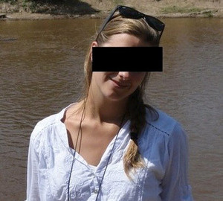
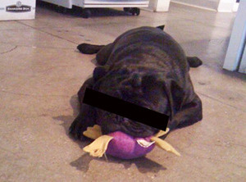
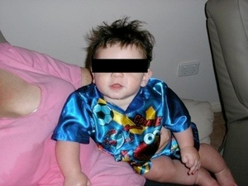
: Fix your pics…
Source: http://gawker.com/5669005/
Source: http://jobs.aol.com/articles/2012/04/18/one-in-three-employers-reject-applicants-based-on-facebook-posts
Source: http://jobs.aol.com/articles/2012/04/18/one-in-three-employers-reject-applicants-based-on-facebook-posts
Source: http://jobs.aol.com/articles/2012/04/18/one-in-three-employers-reject-applicants-based-on-facebook-posts

Slide 24
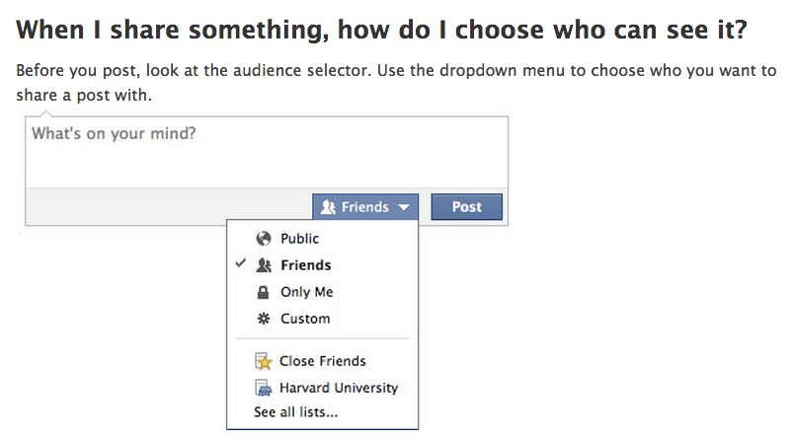
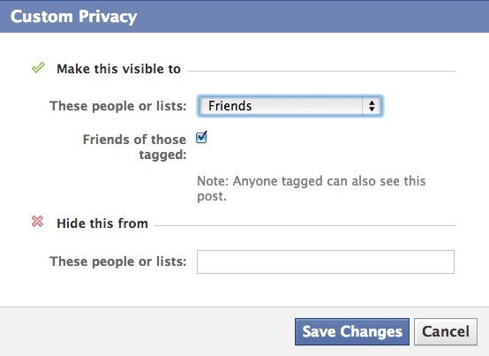
: Protect your privacy.
Source: http://www.facebook.com/help/?faq=120939471321735
Source: http://jobs.aol.com/articles/2012/04/18/one-in-three-employers-reject-applicants-based-on-facebook-posts
Source: http://jobs.aol.com/articles/2012/04/18/one-in-three-employers-reject-applicants-based-on-facebook-posts
Source: http://jobs.aol.com/articles/2012/04/18/one-in-three-employers-reject-applicants-based-on-facebook-posts

Slide 25
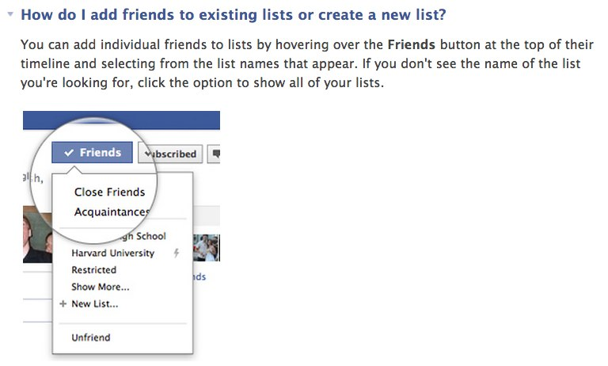
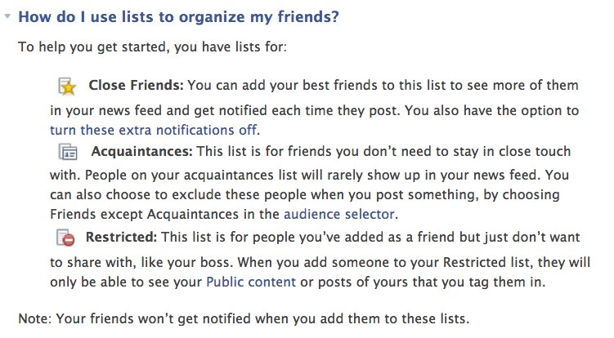
: Be strategic with lists.
Source: http://www.facebook.com/help/204604196335128/
Source: http://jobs.aol.com/articles/2012/04/18/one-in-three-employers-reject-applicants-based-on-facebook-posts
Source: http://jobs.aol.com/articles/2012/04/18/one-in-three-employers-reject-applicants-based-on-facebook-posts
Source: http://jobs.aol.com/articles/2012/04/18/one-in-three-employers-reject-applicants-based-on-facebook-posts

Slide 26
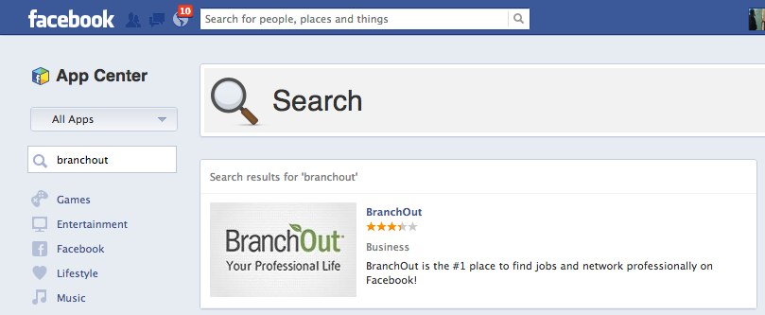
: Don’t take it personal.
Expand your career network to include friends/family
Capitalize on your strongest connections
Search where people spend most of their time online

Slide 28
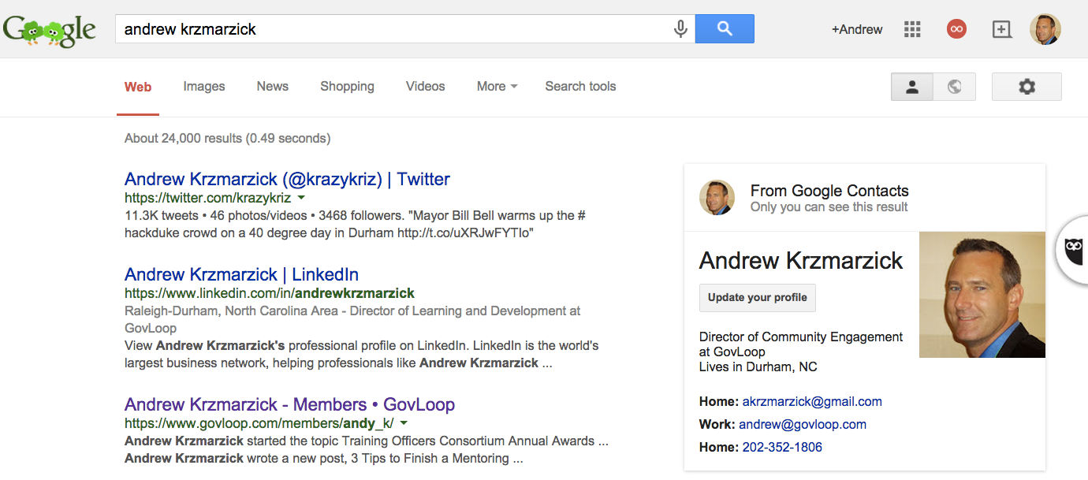
: Search yourself.

Slide 29
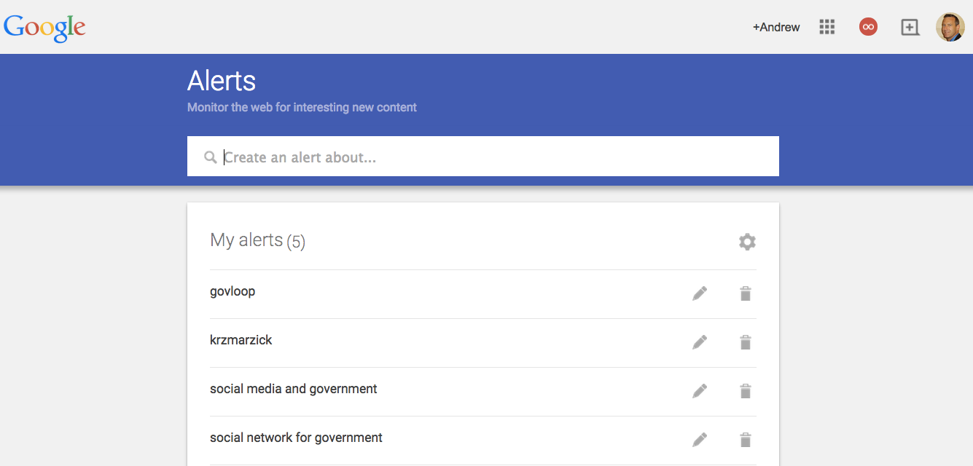
: Set up alerts.

Slide 30
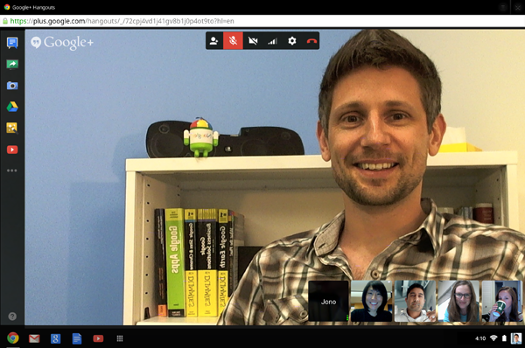
: “Face to face” interview
Notes:
SADS!!!!! Reader is gone.

Slide 32
: Good advice, Part 1.
“How to Win Friends and Twinfluence People”
Advice from Dr. Mark Drapeau (@cheeky_geeky)
WIN FRIENDS
1. Be unique, but be yourself
2. Participate in conversation
3. Bring value to a community
TWINFLUENCE PEOPLE
4. Find the influencers
5. Become an authority
6. Be creative

Slide 33
: Good advice, Part 2.
Other Good Advice
Use Twitter hashtags.
RT regularly.
Participate in live chats.

Slide 34
: A helpful resource!
GovLoop.com/resources/new-twitter-guide-for-government-employees/

Slide 35
: Sonny’s Story
“I first heard about my current job vacancy via Twitter :)
So I can say without any reservation that social media has helped my career in a significant way.”

Slide 36
Questions? Ideas? Stories?

Slide 37
Let’s Connect.
GovLoop.com/profile/AndrewKrzmarzick
LinkedIn.com/in/AndrewKrzmarzick
@krazykriz
andrew@govloop.com
Notes:
SADS!!!!! Reader is gone.

