Slide 1
Deaf in Government Mentoring Program
Jeffrey Dallos, Executive Assistant for Special Projects
David Cardenas, Board Member at Large
Kirsten Poston, Director of Career Advancement
November 10, 2020
7:00 PM EDT

Slide 2
Objectives
Explain DIG’s Mentoring Program
Understand the mentor/mentee roles
Best Practices as a mentor
Building a mentoring relationship
Tools to prepare for and drive the process

Slide 3
What is DIG’s Mentoring Program?
Purpose:
Tap into the existing knowledge, skills, and experience of DIG members who are high performing government employees and transfer the skills to newer DIG members needing a guidance on a pathway to advance their careers.

Slide 4
What is a Mentor?
An individual who guides another individual (mentee) by building trust and modeling positive behaviors.
Understands that his or her role is dependable, engaged, authentic, and tuned into the needs of the mentee.

Slide 5
What are some things a mentor does?
Takes a long-range view of your growth and development.
Helps you see the destination but does not give you a detailed map to get there.
Offers encouragement and guidance.

Slide 6
What a mentor does not do?
Serve as a coach/boss.
Function as an advocate of yours in the workplace.
Tell you how to do things.
Support you on transactional, short-term problems.
Serve as a counselor or therapist.

Slide 7
What is a Mentee?
Is is a person who wants to learn from the mentor.
Have the ambition and desire to increase knowledge.
Gain an effective knowledge, skills, experience, information and advice from a mentor.

Slide 8
Benefits to the mentee
Share from another person’s experience
Mentee demonstrates the employer recognition of knowledge, skills and abilities
May help career advancement.
Gives insight into organizational culture
Increases confidence by moving out of comfort zone

Slide 9
Successful Mentoring Program
Mentor and Mentee should:
Communicate and respect each other’s time,
Share responsibility for the relationship,
Keep an open mind, be flexible, and exchange information,
Sensitive to differences in race, gender, backgrounds, and experiences
Mentee must take ownership of his or her own career.

Slide 10
Resources & Tools
Resume review
Planners
Mock interview questions
SMART Goals
https://www.growthmentor.com/blog/ted-talks-on-mentorship/

Slide 11
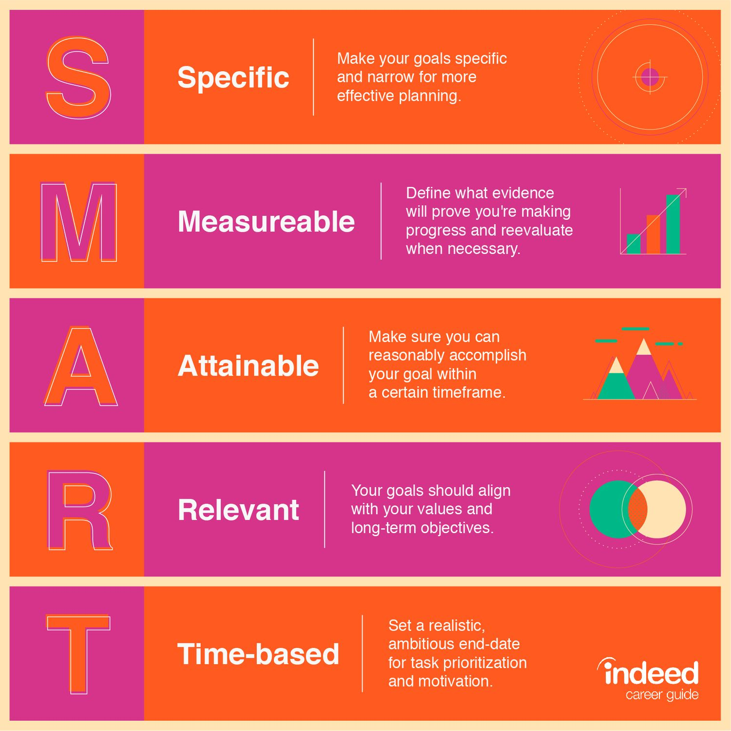
SMART GOALS

Slide 12
MORE TOOLS
Ask “High Gain” questions:
“Tell me more about …”
“What led you there?”
”How did you feel about that?”
”What have you learned?”

Slide 13
Program Timeline
Visit the DIG Website www.deafingov.org
Application Process - November 10- November 30
Match Mentors/Mentees - week of December 14
Six-month Pilot will begin from January 1, 2021 to June 30, 2021

Slide 14
ConTacT
Mentoring@deafingov.org

